Slide 1

Inferring the interplay between network structure and market effects in bitcoin
New journal of physics 16 (2014)
DáNiel kondor, istván csabai, jános szüle, márton pósfai & gábor vattay
BY: Sanjif rajaratnam

Slide 2


Presentation overview
1.0 Paper Overview
2.0 Bitcoin Background Information
3.0 Methodology
4.0 Data Mining
5.0 Extracting the core network
5.1 Core Details
6.0 Detecting Structural Changes
6.1 Daily Snapshots
6.2 PCA
6.2.1 PCA Background Information
7.0 Results
8.0 Conclusion
9.0 Future Work
10.0 Applicability to MIE1512H Research Project
11.0 References

Slide 3
1.0 Paper Overview
Research Question
“Aim to identify relevant changes in network structure over time and to uncover the relation of network structure and macroeconomic indicators of the system”
Data
Bitcoin’s Transaction Network
Procedure
Unsupervised identification of important features in the variation of the network over time
Analytical Method
Principal Component Analysis (PCA)

Slide 4

2.0 bitcoin background information
Digital currency
Decentralized
No central governing authority
Finite Currency
Bitcoins are produced via “mining”
Mining rewards half every 210,000 blocks
Anonymous users
Bitcoin accounts are anonymous ‘addresses’
Users can have multiple addresses to protect their identity
Transparent
General ledger in the form of a Blockchain available to all users
Everyone knows how much Bitcoins belong to one address

Slide 5
3.0 Methodology
Using the Bitcoin transaction network,
Construct daily snapshots of transactions on the network
Find subgraphs of the most active users
Convert the subgraphs into a matrix where each row corresponds to a day’s transactions
PCA to identify key features in the evolution of the network over time
Compare the time variations of the network to the exchange rate of Bitcoins

Slide 6
4.0 Data mining
Data acquired from a slightly modified version of the open-source bitcoind client
Bitcoind
Bitcoin Daemon
Command-line interface for Bitcoin
Data: Entire list of transactions for 2012/2013 on March 3, 2014
Specifically:
Sending addresses
Receiving addresses
Value sent
Time of transaction

Slide 7
5.0 Extracting the core network
Goal: extract subgraph of most active users
‘Contraction’ of graph
Identify addresses belong to the same user using a simple heuristic method
Identify all transactions with multiple inputs and consider addresses in the same transaction as belonging to the same user
In user graph, Users (v) are nodes, and transactions are links
2. Identify ‘active core’ using two methods:
a. Long Term (LT) Core: users active in > 100 individual transactions for > 60 days
b. All Users (AU) Core: 2000 most active users
3. Exclusions:
Exclude users associated with the Satoshi gambling site

Slide 8
5.1 core details
 | LT Core | AU Core
Nodes | 1,639 | 1,288
Edges | 4,333 | 7,255
Addresses | 1,894,906 | 3,326,526
Transactions | 4,837,957 | 12,900,964
% of All Transactions | 17.3% | 46.2%

Slide 9
6.0 detecting structural changes
Method: Compare successive daily snapshots of graph structure with Principal Component Analysis (PCA) to extract important changes
Goal: Obtain a set of ‘base networks’ and represent each day as a linear combination of these base networks
Daily Snapshot: A weighted network, where the weight of a link is equal to the number of transactions that occurred between node u and v.
Perform PCA to determine significant basis vectors on a matrix of concatenated daily snapshots.

Slide 10
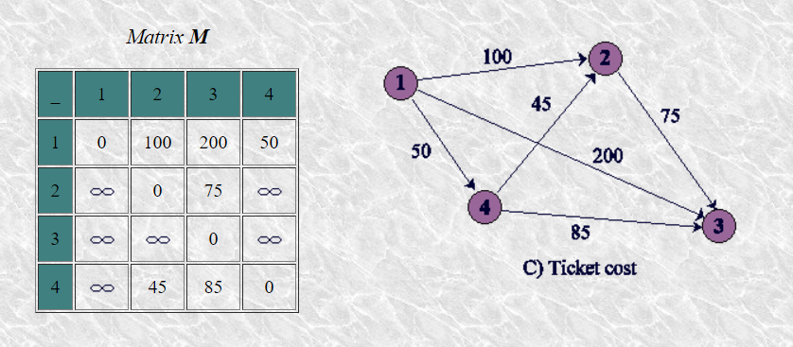
6.1 daily snapshots
Construct a weighted network, where the weight of a link is equal to the number of transactions that occurred between node u and v.
Each daily snapshot is weighted adjacency graph:
Rearrange into vectors and concatenate all daily snapshot vectors into a matrix
Perform Singular Value Decomposition on the constructed matrix

Slide 11

6.2 Principal component analysis (PCA)
Dimensionality Reduction
Multivariate statistic technique
Preprocessed such that the mean of every column is 0
Customary to standardize each variable to unit norm: Divide by square root of all the squared elements of this variable
Choose basis vectors to maximize covariance along one axes
Represent information as a set of orthogonal variables known as principal components
Matrix decomposed via Singular Value Decomposition (SVD)
$X=UΣV^{T}$
Goal of PCA:
Extract the most important information from the data table
Compress the size of the data set by keeping only this important information
Simplify the description of the data set
Analyze the structure of observation and variables
Done by:
Computing new variables called principal components which are obtained as linear combinations of the original variables
The first PCA has the largest possible vvariance such that it will explain the largest part of the table
The second is constrained to be orthogonal to the first while having the largest possible inertia and aso on
Available as a function in Spark MLLib

Slide 12
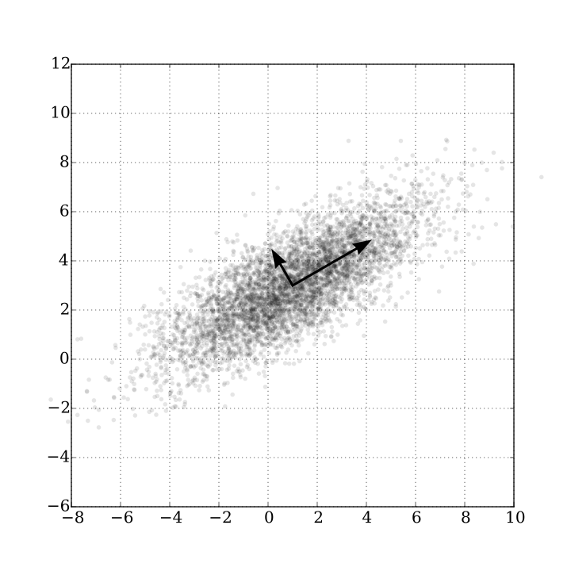

6.2 Principal component analysis (PCA)
Finding the components
Do SVD
The I x L matrix of factor scores is denoted by F:
$F=UΣ$
The matrix V gives the coefficients of the linear combinations used to compute the factors score. This matrix can be interpreted as the projection matrix because multiplying X by V gives the values of projection of the observations on the principal components.
$F=UΣ=UΣVV^{T}=XV$
The matrix V is also called the loading matrix
Orthogonal Transformation that converts a set of observations of possibly correlated variables into a set of values of linearly uncorrelated variables called principal components
Constructed such that the first principal component has the highest possible variance

Slide 13

7.0 Results
Both cores decay relatively slowly so several components are required to obtain a good approximation of the original matrix
Indication that system contains Non-Gaussian noise and high dimensional structure
Distribution of edge weights is fat-tailed: First 6 base networks have very similar distributions and are well approximated with $p_{i}\left(v\right)\sim v^{−1.8}$ for LT core and $p_{i}\left(v\right) \sim v^{−1.9}$ for AU core
Examining edges with large weights for the LT core, we find that most of these are repeated within the first few base networks
E.g. if we consider the top-20 ranking edges (by the absolute value of weights) in the first ten base networks, we find only 46 distinct edges (by the absolute value of weights) in the first ten base networks, we find only 46 distinct edges instead of the 200 maximally possible.
Among these 44 induce a weakly connected graph, including 29 users; considering all the edges among the users, 20 of them form a strongly connected component by themselves and all are weakly connected. These 29 users have a total of 1,349,815 separate Bitcoin addresses, forming a highly active subset in our core network

Slide 14
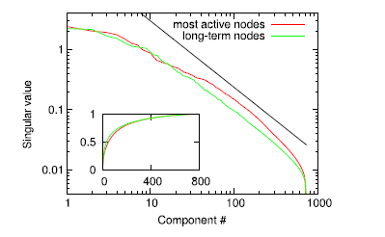
7.0 Results

Slide 15
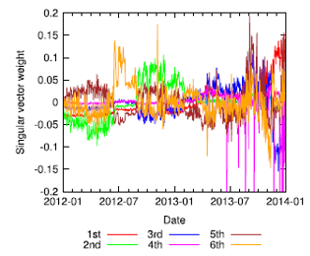
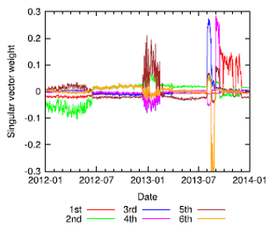
7.0 Results
Time varying contribution $u_{i}(t)$ of the first 6 base networks:
LT core
AU core

Slide 16

7.0 Results
In most cases $u_{i}\left(t\right)$ represent a few abrupt changes, partitioning the history of Bitcoin into separate time periods. This is especially true for the AU Core, where highly active but short lived users can contribute.

Slide 17

7.0 Results
The most striking feature uncovered by our analysis is a clear correspondence between the first singular vector of the graph of long-term users and the market price of Bitcoin
Apart from the visual similarity, the two datasets have a significantly high correlation coefficient
We tested whether the price of Bitcoin can be estimated with the $u_{i}(t)$ coefficients by subtracting the average value of the price time series, and estimate this is a linear combination of singular vectors
$\tilde{B}\left(t\right)= <B\left(t\right)> +Σ_{\left(i=1\right)}^{N}c_{i}u_{i}\left(t\right)$
Here the coefficients $c_{i}$ can be computed as the dot product of the price time series and $u_{i}\left(t\right)$, and therefore $c_{i}$ is proportional to the Pearson correlation coefficient
The residual error is a function of N.
It is apparent that there are sudden decreases in the error after the inclusion of certain base networks
The base vectors are ranked by their similarity to the price time series by using correlation coefficients.
On the other hand, we can rank these components by their similarity to the price time series by using correlation coefficients

Slide 18
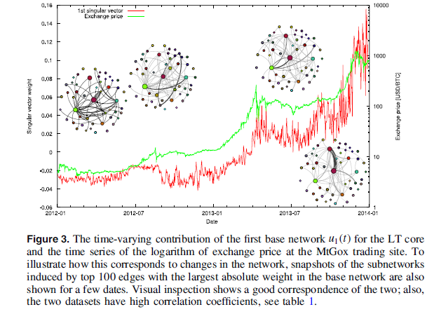
7.0 Results

Slide 19
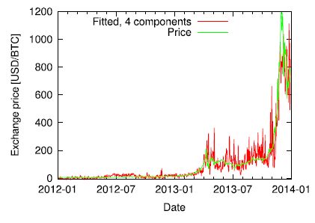
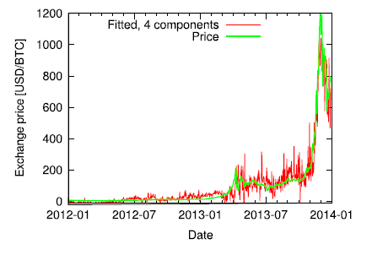

7.0 Results
Two approximations of the time series for the LT core is shown in Figure 5; one with the first four base networks, the other with the four base networks whose time-varying contributions $u_{i}$ has the highest correlation to the price
In both cases, most features of the time series is well approximated, but the fitted time series is apparently noisy
The first case misses the peak at 2013, but it is approximated much better in the second case

Slide 20
8.0 conclusions
Investigated connections between network structure and macroscopic properties
Re-constructed daily snapshots of the network for the most active users
Organized snapshots into a graph time series matrix
Analyzed the matrix using PCA to identify changes in the structure
Striking feature: Found correspondence between market price and network structure
It is apparent that the analysis of the structure of the underlying network of a financial system can provide important new insights complementing analysis of the external features

Slide 21
9.0 future work
Focus on establishing causal relationship between the observed features, and possibly predicting the price changes based on structural changes in the network
Also, collecting publicly available information about Bitcoin addresses identified as members of the highly active core of the network could result in a better understanding of the role of the associated users in the Bitcoin ecosystem, and help explain the correlation observed here

Slide 22

11.0 relation to mie1512H research project
Ethereum is like Bitcoin with publicly available general ledger
Similar analysis can be done with this network to see if a correlation also exists between the exchange rate of Ethereum and the network structure of Ethereum

Slide 23
11.0 References
[1] Paper
[2] http://www.bitcoinblockhalf.com/
[3] https://bitcoin.org/img/icons/opengraph.png
[4] http://www.coindesk.com/information/what-is-bitcoin/
[5] http://bitcoin.stackexchange.com/questions/tagged/bitcoind

Slide 24
The end
Questions?

